Slide 1
The Play that Flooded the Stands
Imperfect Improv and Insolent Inundation
The
Template
had
months
in
these
spots
<
for
some
reason
Nov
Dec
>

Slide 2
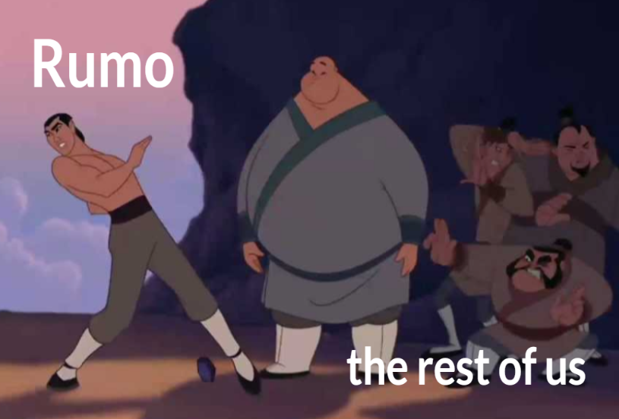
Rumo Trains the Country Bumpkins
Especially Jozari

Slide 3
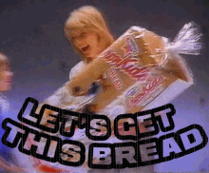
Lyla gets a ton of food
Lyla
The Party

Slide 4
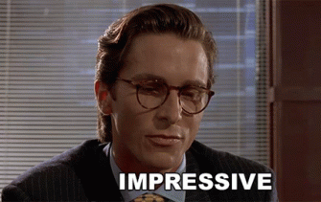
Rumo flexes his networking skillz with Harvey
Harvey
Rumo

Slide 5
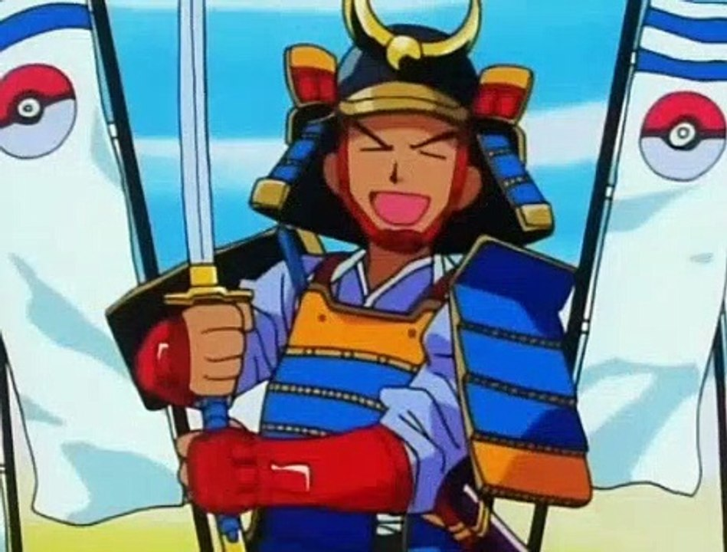
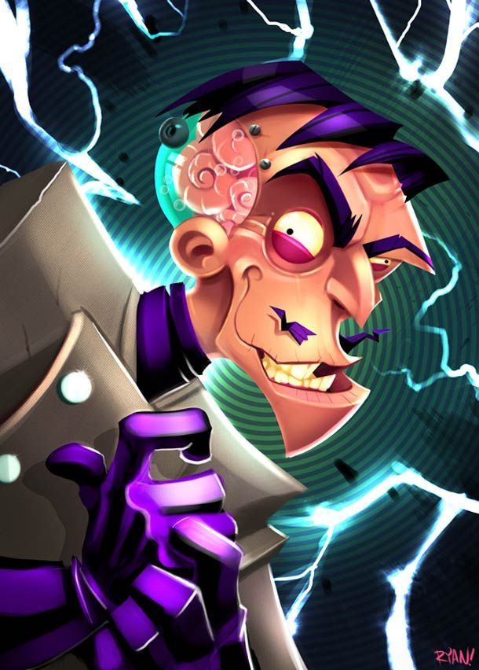
We perform the best damn play in the world
All of Rumo’s Parts
Arthur, our Hero
Jozari, the (not) evil scientist

Slide 6
Jack Ferguson Gives Feedback

Slide 7
Just… This meme

Slide 8
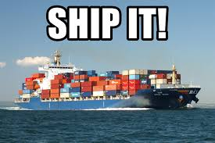
Lyla and Rumo go on a walk to break shit down

Slide 9
WATER ELEMENTALS ATTACK!!!!

Slide 10
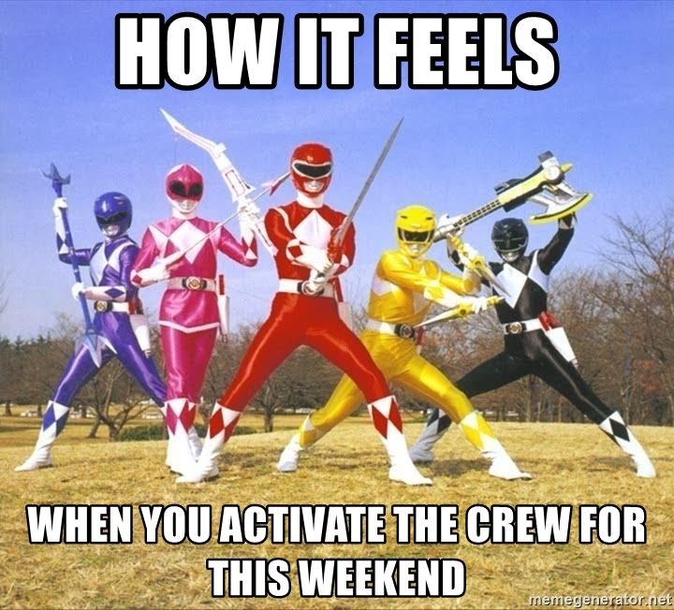
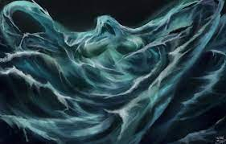
WE KICK ASS!!!!!
Pathetic excuse for a villain
Us

Slide 11
Allstar moments
Harvey helps civilians escape
Bedoof is a Bossdoof
Arthur and all his mons go down
Deerling grass type is clutch
Lotad typing OP
Harvey lends a Helping Hand

Slide 12
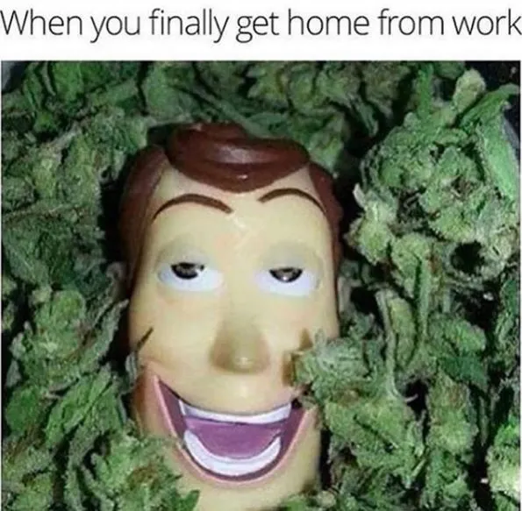
Lyla gets some herbs after the hard work

